Slide 1

College Admission Management System
B.TECH PROJECT PRESENTATION
AHBAB AHMAD [2005110100008] ARJUN SETHIYA [2005110100019] AYUSH CHOUBEY [2005110100022] UJJWAL YADUVANSHI [2005111520020]
Supervisor Name
ER. SANJIV SINGH

Slide 2
Introduction
Today all the work at the time of admission of the students is done manually by ink and paper, which is very slow and consuming much efforts and time. In the modern world of technology, computer are affecting our lives in more ways than we probably are aware of COMPUTERIZED MANAGEMENT maintaining information of an educational institute, colleges, other the list is endless. The main principle behind the need of college admission system is easy supervision of institutes. It can handle the details of students such as personal details or admission details. This Student Database has been designed taking into account the practical needs to manage a Students data. Moreover, it provides security at product level as well as user level. Its design concentrates on 2 types of users:
Admin
Students

Slide 3

ADMIN MODULE
Dashboard: In this section, the admin can see all the detail in brief.
Reg Users: In this section, the admin can view user detail, delete and update user detail.
Admission Application: In this section, admin can view all applications. Admin can view applications and documents on the basis of status(pending application, approved an application, and reject application). Admin also can approve the pending application. (Whenever the admin changes the status of the application user will get an email notification). Note: The email function will not work in localhost.
Search Application: In this section, admin can search applications on the basis of user name, email id, and contact number.
Course: In this section, admin can manage courses(add, delete and update).
Notice: In this section, admin can manage notice(add and update) and anybody see this notice on the website.
Notification: In this section, admin gets the notification if any user applies for admission.
Pages: In this section, Admin can manage the content of the about us and contact us page.
Subscribers: In this action , admin can view the subscriber list.
Reports: In this section, admin can generate the report b/w dates.

Slide 4
USER / STUDENT MODULE
User can contact the administrator by sending mails.
User can view the about us and contact us page.
User can view notices which are published by the admin.
User can view courses that are listed by the admin.
User can register themselves.
After User/Student Login
1.Dashboard: In this section, user can see the status of his application.
2.Admission Form: In this section, user can fill the form and check his / her application form is selected or rejected(which is done by admin).
3.Submit Fees: In this section, If user/student application is selected user can submit their fees.
A user can also update his/ her profile, change the password and recover the password.

Slide 5
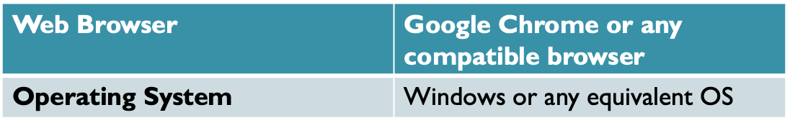
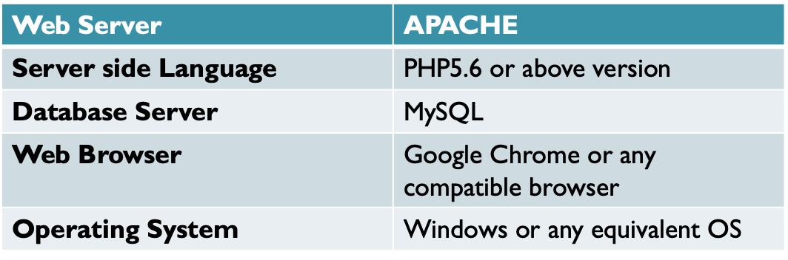
Methodology Adopted
Software Requirement : Client Side
Server Side

Slide 6
Objective
The main goal of the system is to automate the process carried out in the organization with improved performance and realize the vision of paperless admission. Some of the goals of the system are listed below:
qManage large number of student details.
qManage all details of student who registered for the course and send appropriate details about the course to the students account.
qCreate student accounts and maintain the data’s effectively.
qView all the details of the students.
qCreate the statistical reports.
qReduce the work load in interview the students for selection and Counseling should be very effective rather than direct methods.

Slide 7
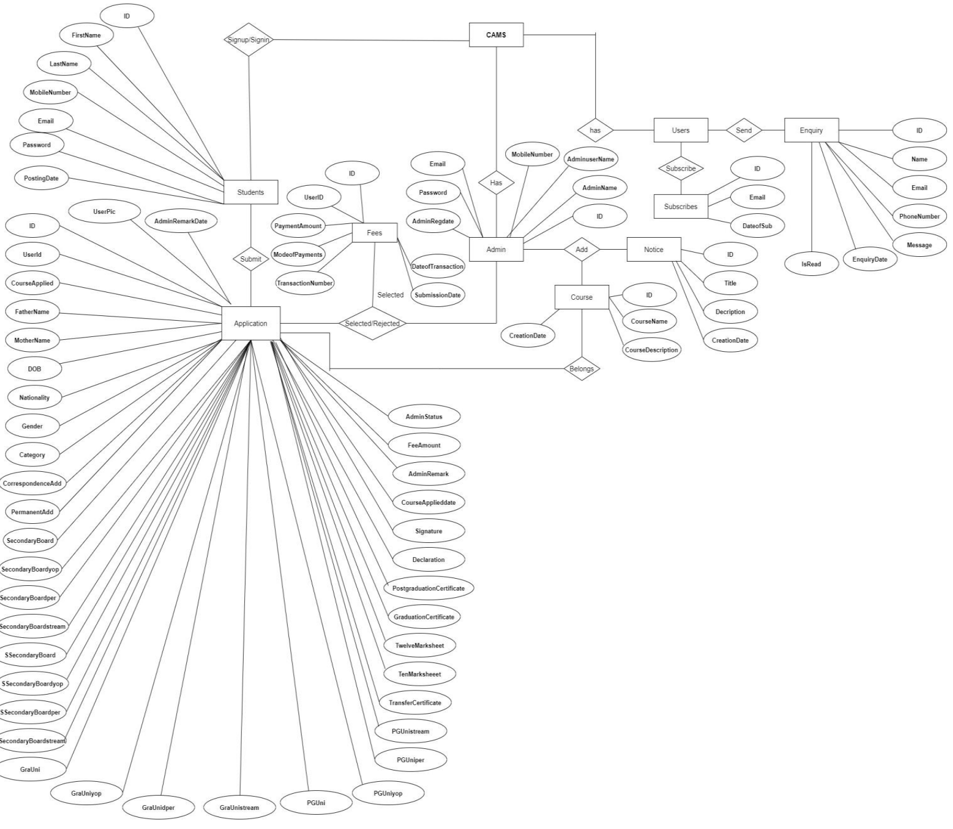
E-R DIAGRAM

Slide 8
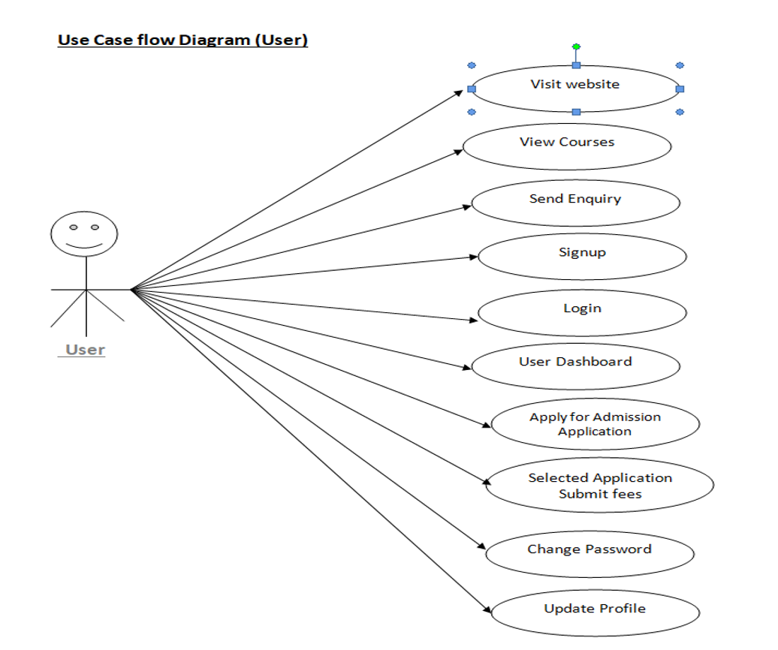
USE CASE DIAGRAM [USER]

Slide 9
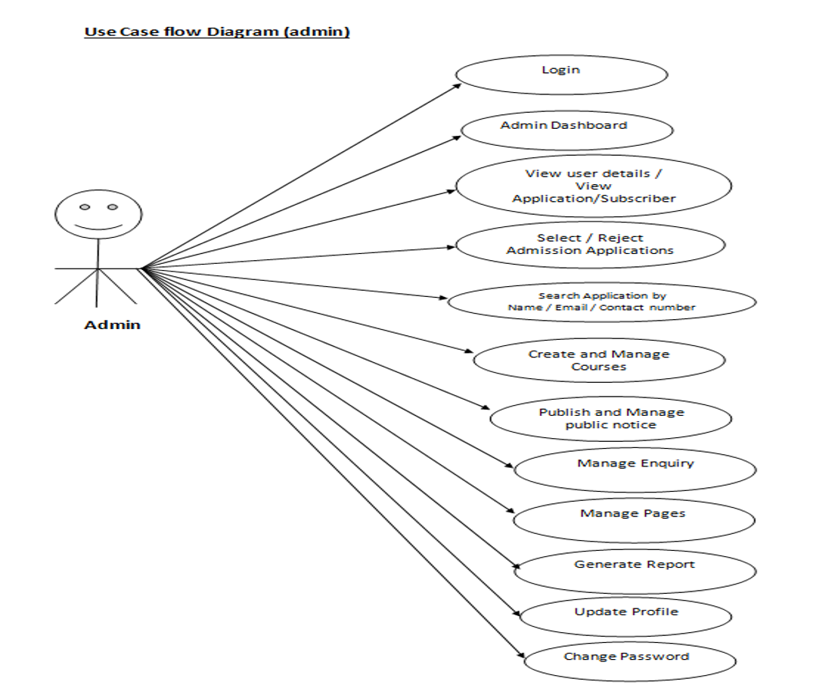
USE CASE DIAGRAM [ADMIN]

Slide 10
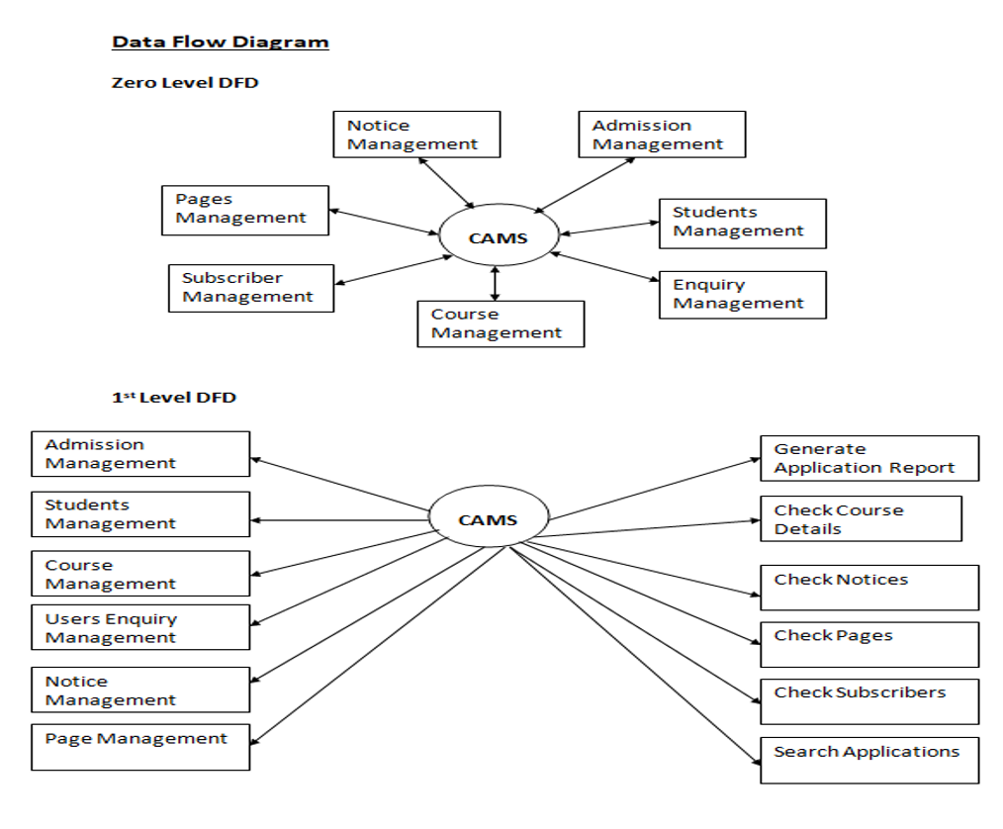
DFD(DATA FLOW DIAGRAM)

Slide 11
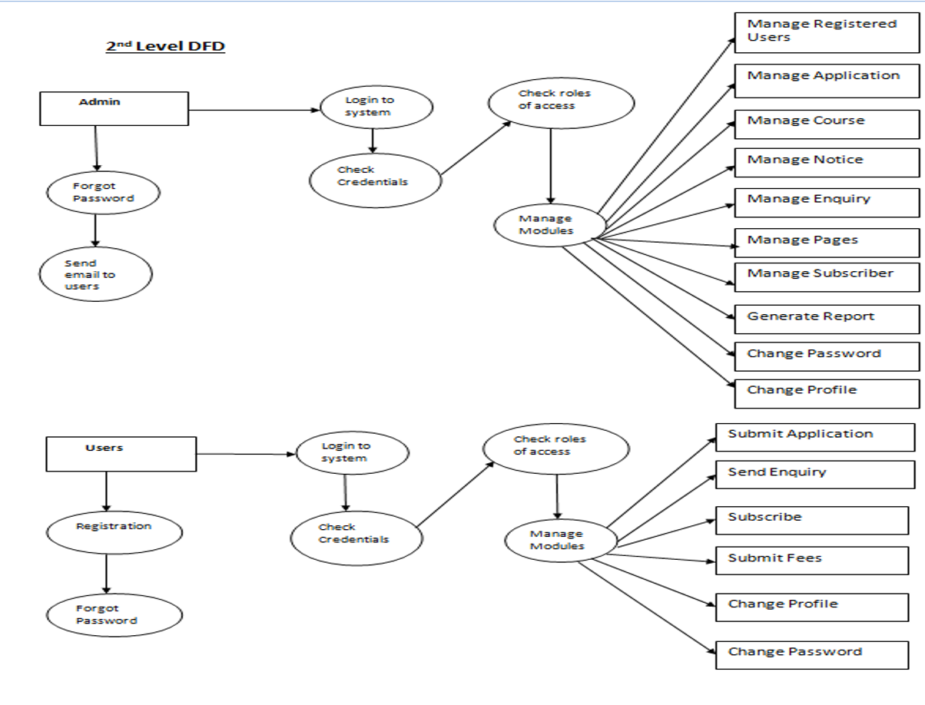

Slide 12

Project Outcomes/Course Outcomes
Single Slide
(Point wise)

Slide 13
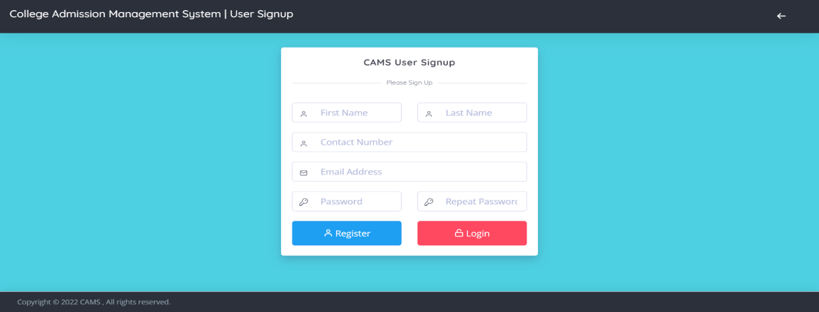
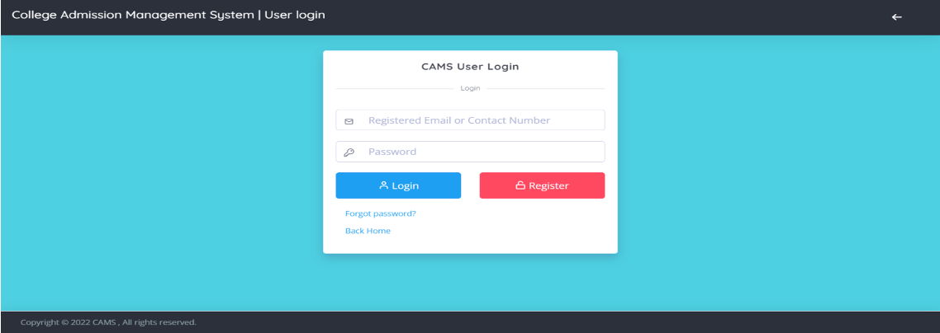

Slide 14
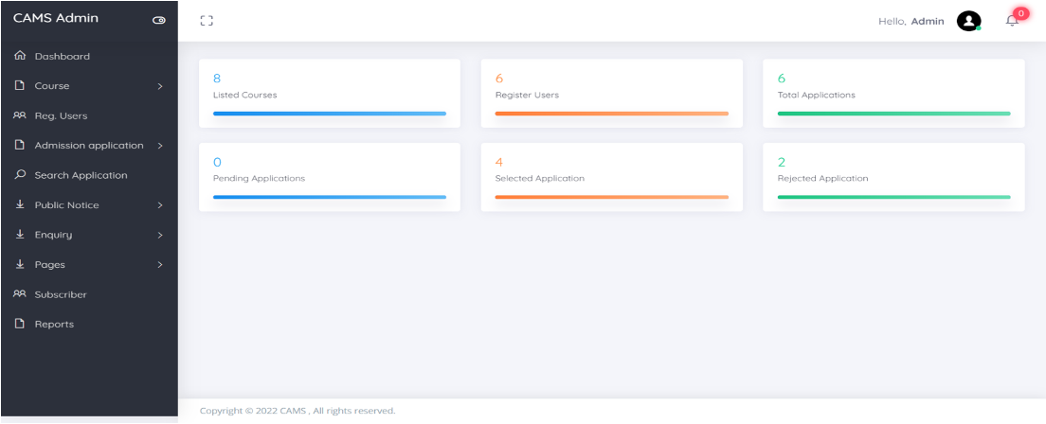
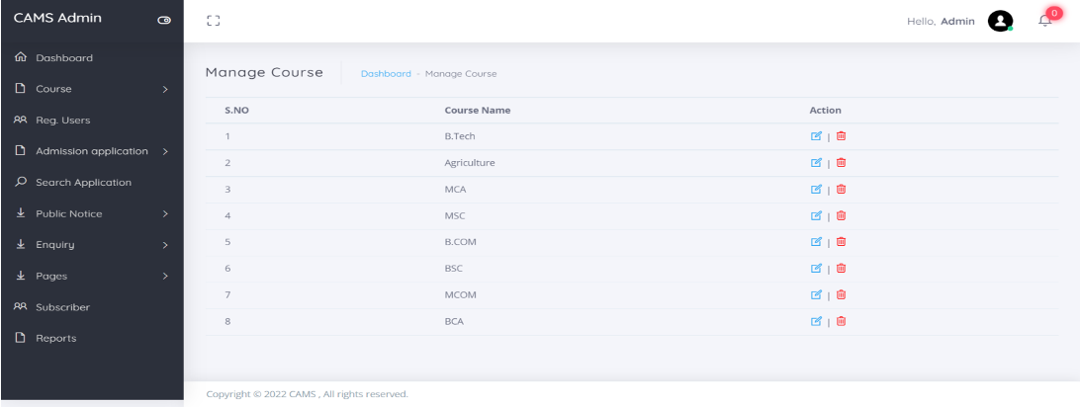

Slide 15
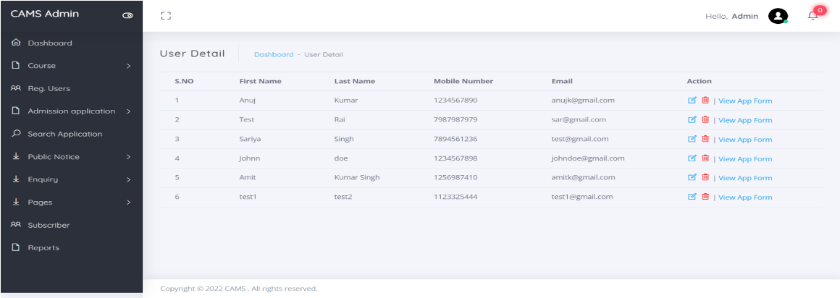
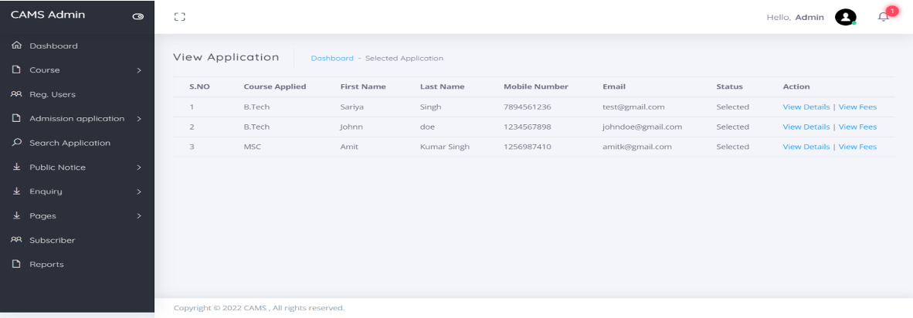

Slide 16
Implementation and System Testing
After all phase have been perfectly done, the system will be implemented to the server and the system can be used.
System Testing
The goal of the system testing process was to determine all faults in our project .The program was subjected to a set of test inputs and many explanations were made and based on these explanations it will be decided whether the program behaves as expected or not. Our Project went through two levels of testing
Unit testing
Integration testing

Slide 17

References
For PHP
qhttps://www.w3schools.com/php/default.asp
qhttps://www.sitepoint.com/php/
qhttps://www.php.net/
For MySQL
qhttps://www.mysql.com/
qhttp://www.mysqltutorial.org
For XAMPP
qhttps://www.apachefriends.org/download.html

Slide 18
Thank You

